Slide 1
[ OptyX ]
Aarchit M.
Aliza N.
Kfir B.
Nicole R.
Wilson R.

Slide 2
[ Retail Options Trading Trends ]
Retail option trading increased approximately 35% from 2020 - 2021 Potentially due to increase in liquidity: increase in disposable income for some (savings during lockdown + Stimmy)
Position sizing has shown that lower number of contracts per position have drastically increased – showing that number of newer participants with less capital are also engaging in options trading
Also shows shorter length of contracts are being utilized - expiring within 10 days of execution in mid 2021, nearly double the rate since weekly contracts were introduced

Slide 3
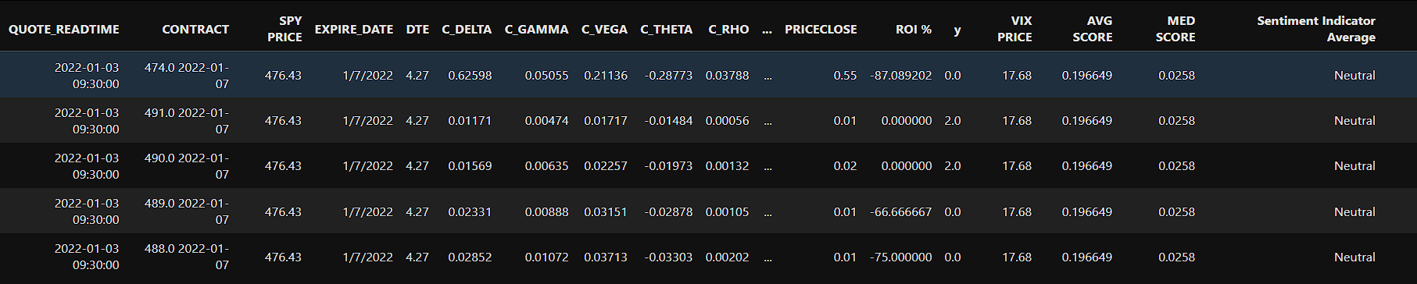
[ Component Analysis ]

Slide 4

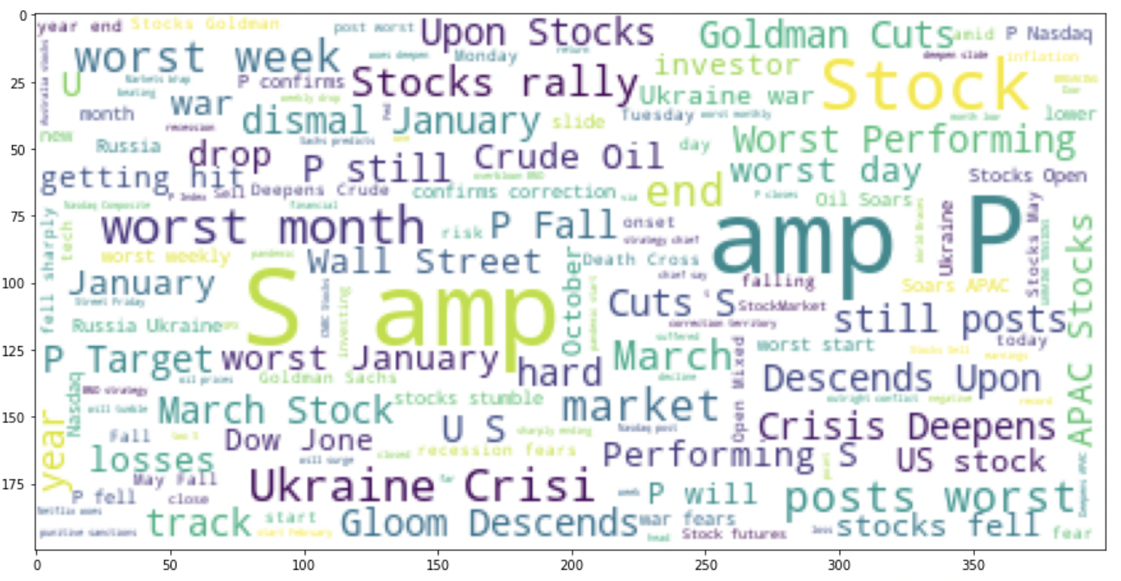
[ Sentiment Analysis ]
#for extremely bearish tweets
bear_sentences = Extremely_Bearish['text'].tolist()
bear_sentences_as_one_string = " ".join(bear_sentences) plt.figure(figsize = (15,15))
wordcloud = WordCloud(background_color='white',max_font_size = 40).generate(bear_sentences_as_one_string) plt.imshow(wordcloud)
This Photo by Unknown Author is licensed under CC BY

Slide 5
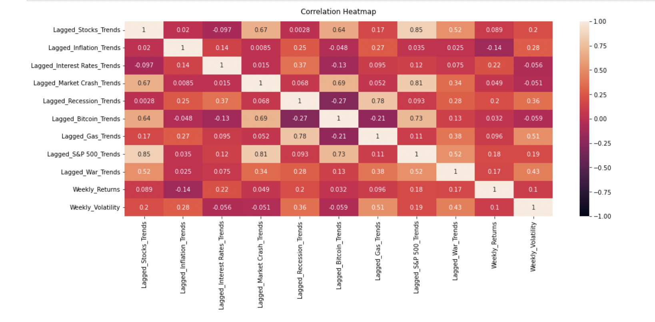

Slide 6
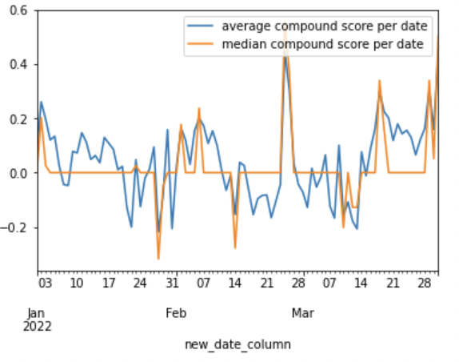
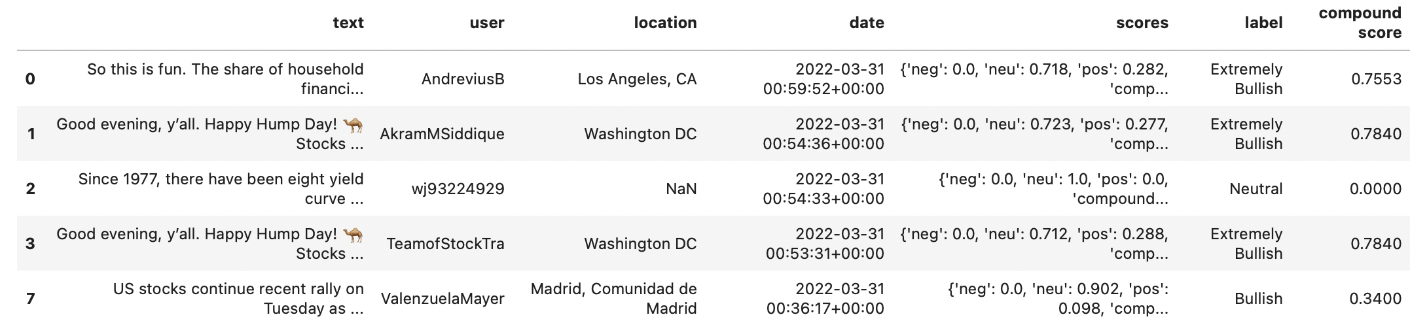
def sentimentPredict(sentiment): if sentiment['compound'] >= 0.0: return sentiment['compound'] else: return sentiment['compound’]
final_df_score = df_tweets final_df_score['compound score'] = df_tweets['scores'].apply(lambda x: sentimentPredict(x))
display(final_df_score.head()) display(final_df_score.tail())

Slide 7


[ Features]
Y Categories Classification
0 = "Strong Sell Short” -60%
1 = "Sell Short” -60%-10%
2 = "Pass” -10%-+10%
3 = "Buy" +10%-+60%
4 = "Strong Buy” +60%-+100%
5 = "Very High Return” over 100%
[ SPY Price ]
[ Days To Expiration ]
[ Call Delta ]
[ Call Gamma ]
[ Call Vega ]
[ Call Theta ]
[ Call Rho ]
[ Call Volume ]
[ Recent Call Price ]
[ Strike Distance ]
[ Inflation % ]
[ VIX Price ]
[ Sentiment ]

Slide 8
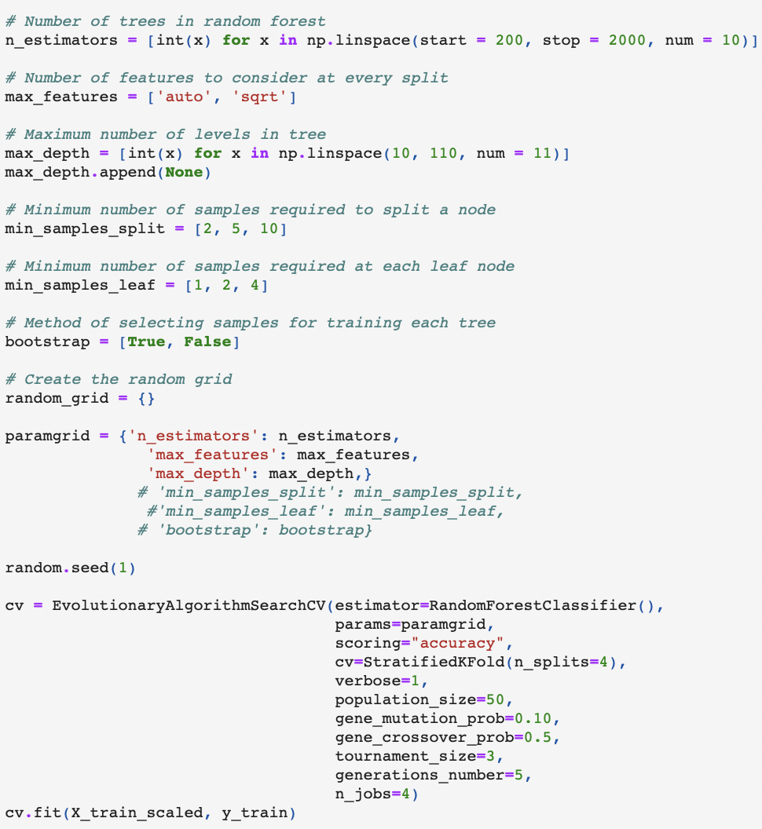
[ Hyperparameter Tuning for Random Forest ]

Slide 9
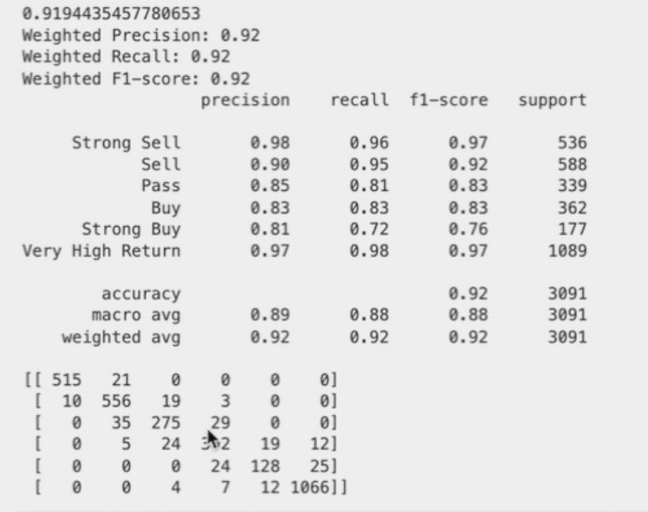
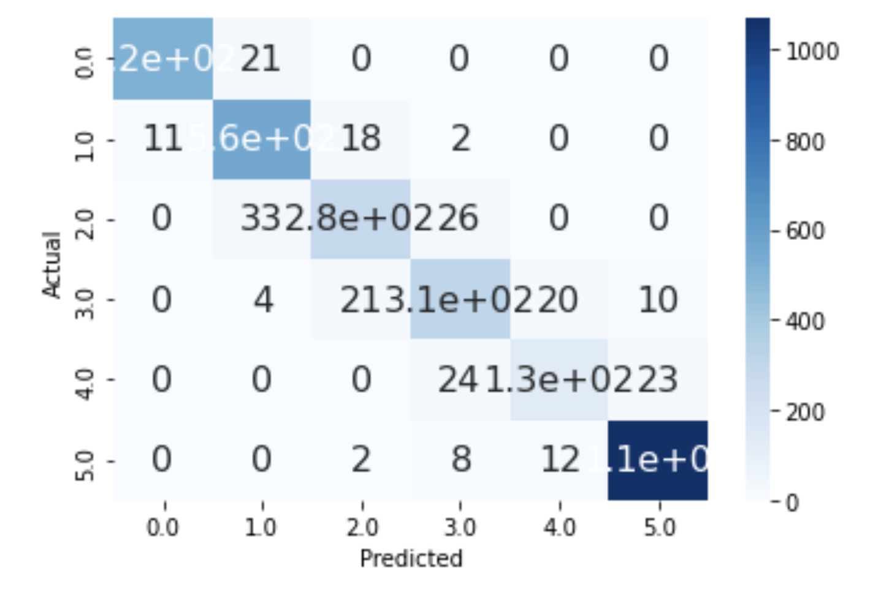
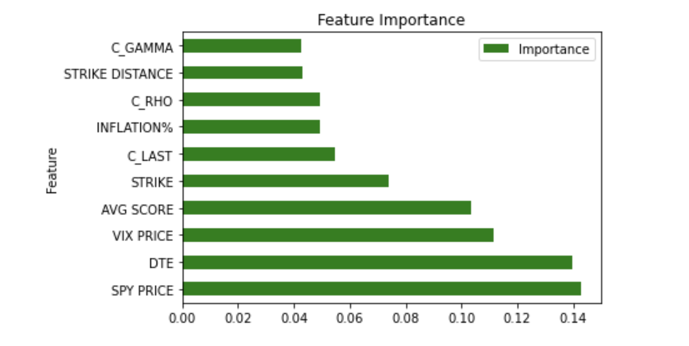
[ Results ]

Slide 10

[ What’s next for OptyX? ]

Slide 11


